Slide 1
20XD24 - OBJECT ORIENTED PROGRAMMING Chapter – V Inheritance

Slide 2
Outline
Defining Derived Classes
Single Inheritance
Making a Private Member Inheritable
Multiple Inheritance
Hierarchical Inheritance
Hybrid Inheritance
Virtual Base Classes
Function overriding
Constructors in Derived Classes
Member Classes - Nesting of Classes
Composition
Aggregation

Slide 3
Inheritance
Inheritance allows a new class to be created using an existing class
The new class inherits all the member variables and functions (except the constructors and destructor) of the class it is based on
The mechanism by which more-specific elements incorporate the structure and behavior of more-general elements - Booch, Rumbaugh, & Jacobson, 2005
Inheritance is one of the ways in object-oriented programming that makes reusability possible
Reusability means taking an existing class and using it in a new programming situation
By reusing classes, we can reduce the time and effort needed to develop a program, and make software more robust and reliable

Slide 4
Inheritance
Inheritance is a process of one class acquiring the features of another class
It is a way of creating new class(derived class) from the existing class(base class) providing the concept of reusability
Doctor
Name
Qualification
Operate
Base Class
Dentist
Tooth Specialist
Cardiologist
Heart Specialist
Derived Class
A Surgeon “is a” Doctor. A Doctor need not be a surgeon

Slide 5
Inheritance
By using the concepts of inheritance, it is possible to create a new class from an existing one and add new features to it
The class being refined is called the superclass or base class and each refined version is called a subclass or derived class.
Semantically, inheritance denotes an “is-a” relationship between a class and one or more refined version of it
Attributes and operations common to a group of subclasses are attached to the superclass and shared by each subclass providing the mechanism for class level Reusability

Slide 6
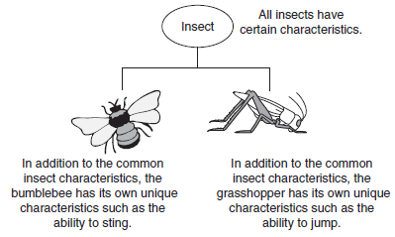
Inheritance
Person
Name
Sex
Age
Student
Reg.No.
Course
Marks
Teaching Staff
Edn.Qual.
Designation
Specialization
“Person” is a generalization of “Student”
“Student” is a specialization of “Person”

Slide 7
Inheritance and the “is a” Relationship
When one object is a specialized version of another object, there is an “is a” relationship between them
For example, a grasshopper is an insect
A few other examples of the “is a” relationship
A poodle is a dog
A car is a vehicle
A tree is a plant
A rectangle is a shape
A football player is an athlete
When an “is a” relationship exists between classes, it means that the specialized class has all of the characteristics of the general class, plus additional characteristics that make it special
In object-oriented programming, inheritance is used to create an “is a” relationship between classes

Slide 8
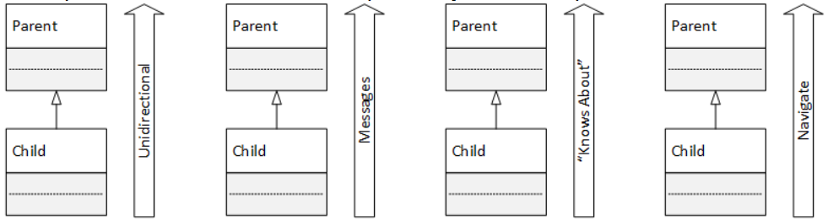
Inheritance Characteristics
Semantics. Inheritance is the only is a relationship, so its semantics or meaning is the fundamental difference between inheritance and the other relationships
Directionality. Inheritance is a unidirectional or a one-way relationship
Unidirectionality means
the operations may only take place in one direction: from the child to the parent
the subclass or child object can send a message to the superclass or parent object, which can respond to a child's messages but cannot initiate message sending
the child "knows" about the parent but the parent doesn't "know" about the child
it is possible to navigate from the child to the parent object but not from the parent to the child

Slide 9
Inheritance Characteristics
Binding Strength. The binding between the two objects is very strong or tight because the superclass or parent object is literally embedded inside the subclass or child object
The strength of the bond implies the final two characteristics
Lifetime : The two objects have a coincident lifetime, which means that the two objects are created and destroyed at the same time. It also means that the relationship between the two objects is permanent - the relationship cannot be altered or broken.
Sharing : The binding between the two objects is so tight or strong that it forms an exclusive relationship - the subclass or child object does not share its superclass or parent object with any other object in the program

Slide 10
Inheritance
The simplest example of inheritance requires two classes:
a base class and a derived class
The base class does not need any special syntax
The derived class, on the other hand, must indicate that it’s derived from the base class
This is done by placing a colon after the name of the derived class, followed by a keyword such as public and then the base class name

Slide 11
Defining Derived Class
The general form of deriving a subclass from a base class
class derived-class-name : visibility-mode base-class-name
{
……………… //
……………….// members of the derived class
};
The visibility-mode (private or public or protected) is optional
It may be either private or public or protected, by default it is private
This visibility mode specifies how the features of base class are visible to the derived class

Slide 12
Protected Visibility Mode
C++ controls the visibility or accessibility to the parts of a class with three keywords
Private
The feature is visible and accessible only from within an instance of the defining class (i.e., it is only accessible in one of the class's member functions)
Although a subclass inherits all its superclasses' private members, it cannot "see" or access them directly. Instead, the subclass must use the public interface inherited from the superclass
Public
The feature (member data or member function) is visible and accessible throughout a program
Protected
Protected features are visible and accessible by the defining class and by all its subclasses (as if the features were public). But protected features are completely invisible and inaccessible to classes that are not subclasses of the defining class (as if the features were private)

Slide 13
Defining Derived Class
class Teacher { // Base class
private: // means public for derived class members
string name;
int age, numberOfStudents;
public:
void setName (const string & new_name) { name = new_name; }
};
class Principal : public Teacher { // Derived class
string schoolName; // Additional members
int numberOfTeachers;
public:
void setSchool(const string & s_name) { schoolName = s_name; }
};

Slide 14
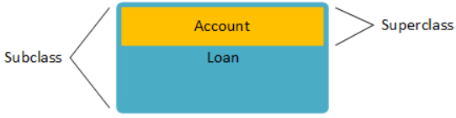
Inheritance And Objects
Instantiating a subclass
Whenever a program instantiates a subclass, it simultaneously instantiates the superclass (all the superclass's )
When the compiler organizes the objects in memory, the superclass object is nested or embedded inside the subclass object. Furthermore, it places the superclass object at the top of or at the subclass object's beginning

Slide 15
Access Control
Remember, when inheritance is not involved, class member functions have access to anything in the class, whether public or private, but objects of that class have access only to public members
Once inheritance enters the picture, other access possibilities arise for derived classes. Member functions of a derived class can access public and protected members of the base class, but not private members
Objects of a derived class can access only public members of the base class

Slide 16
Access Control
Access Specifiers and their scope
Access control to class members
Base Class Access Mode | Derived Class Access Modes
 | Private derivation | Public derivation | Protected derivation
Public | Private | Public | Protected
Private | Not inherited | Not inherited | Not inherited
Protected | private | Protected | Protected
Function Type | Access Directly to
 | Private | Public | Protected
Class Member | Yes | Yes | Yes
Derived Class Member | No | Yes | Yes
Friend | Yes | Yes | Yes
Friend Class Member | Yes | Yes | Yes

Slide 17
Public, Protected and Private derivation
The inherited public and protected members of a base class become public and protected members of the derived class
Class A Class B Class B: public A
private :
int a1;
private :
int b1;
private :
int b1;
protected :
int a2;
protected :
int b2;
protected:
int a2;
int b2
public :
int a3;
public :
int b3;
public:
int b3;int a3;
Public Derivation

Slide 18
Public Derivation - Example
class A
{
private : int a;
protected: int b;
public : void get_a( ) { cin>>a;}
void get_b( ) { cin>>b;}
void print_a( ) { cout<<a;}
void print_b( ) {cout<<b;}
};
class B : public A
{
private : int c;
protected: int d;
public :
void get_c( ) { cin>>c;}
void get_d( ) {cin >>d;}
void get_all( ) { get_a( ); cin>>b>>c>>d;}
void print_cd( ){ cout<<c<<d;}
void print_all( ) { print_a( ); cout<<b<<c<<d; }
};
int main( )
{
B b1;
b1.get_a( );
b1.get_b( );
b1.get_c( );
b1.get_d( );
b1.print_all( );
}

Slide 19
Public, Protected and Private derivation
The inherited public and protected members of a base class become protected members of the derived class
Class A Class B Class B : Protected A
private :
int a1;
private :
int b1;
private :
int b1;
protected :
int a2;
protected :
int b2;
protected:
int a2;
int b2,a3;
public :
int a3;
public :
int b3;
public:
int b3;
Protected Derivation

Slide 20
Protected Derivation - Example
class A
{
private: int a;
protected: int b;
public : void get_a( ) { cin>>a;}
void get_b( ) { cin>>b;}
void print_a( ) { cout<<a;}
void print_b( ) {cout<<b;}
};
class B : protected A
{ private : int c;
protected: int d;
public : void get_c( ) { cin>>c;}
void get_d( ) {cin >>d;}
void get_ab( ) { get_a( ); get_b( );}
void print_cd( ){ cout<<c<<d;}
void print_all( ) { print_a( ); cout<<b<<c<<d;};
}
int main( )
{
B b1;
b1.get_a( ); //ERROR
b1.get_b( ); //ERROR
b1.get_ab( );
b1.get_c( );
b1.get_d( );
b1.print_all( );
}

Slide 21
Public, Protected and Private derivation
The inherited public and protected members of a private derivation become private members of the derived class.
Class A Class B Class B : private A
private :
int a1;
private :
int b1;
private :
int b1;
int a2,a3;
protected :
int a2;
protected :
int b2;
protected:
int b2;
public :
int a3;
public :
int b3;
public:
int b3;
Private Derivation

Slide 22
Private Derivation - Example
class A
{
private: int a;
protected: int b;
public : void get_a( ) { cin>>a;}
void get_b( ) { cin>>b;}
void print_a( ) { cout<<a;}
void print_b( ) {cout<<b;}
};
class B : private A
{
private : int c;
protected: int d;
public : void get_c( ) { cin>>c;}
void get_d( ) {cin >>d;}
void get_ab( ) { get_a( ); get_b( );}
void print_cd( ){ cout<<c<<d;}
void print_abcd( ) { print_a( ); cout<<b<<c<<d; }
};
class C : public B
{ public :
void get_all( )
{ get_a( ); //ERROR
get_b( ); //ERROR
get_ab( ); //Ok
get_c( ); //Ok
get_d( ); //Ok }
void print_all( )
{ print_a( ); //ERROR
print_b( ); //ERROR
print_cd( ); //Ok
print_abcd( ); //Ok } };
int main( )
{ C c1;
c1.get_a( ); //ERROR
c1.get_b( ); //ERROR
c1.get_c( ); // Ok
c1.get_d( ); //Ok
c1.getall( ); //Ok
c1.print_all( ); //Ok
}

Slide 23
Types of Inheritance
Inheritance are of the following types
Simple or Single Inheritance
Multilevel Inheritance
Multiple Inheritance
Hierarchical Inheritance
Hybrid Inheritance
Virtual Inheritance

Slide 24
Simple Or Single Inheritance
It is a process in which a subclass is derived from only one superclass
A Class Student is derived from a Class Person
Person
class Person
{ ….. };
class Student : public Person
{
……
};
superclass(base class)
Student
subclass(derived class)
visibility mode

Slide 25
Multilevel Inheritance
The method of deriving a class from another derived class is known as Multiple or Varied Inheritance
A derived class CS-Student is derived from another derived class Student
Person
class Person
{ ……};
class Student : public Person
{ ……};
class CS -Student : public Student
{ …….};
Student
CS -Student

Slide 26
Multiple Inheritance
A class is inheriting features from more than one super class
Class Part-time Student is derived from two base classes, Employee and Student
Employee
Student
Class Employee
{……..};
Class Student
{……..};
Class Part-time-Student : public Employee, public Student
{…….};
Part-time-Student

Slide 27
Hierarchical Inheritance
Many subclasses are derived from a single base class
The two derived classes namely Student and Employee are derived from a base class Person
class Person
{……};
class Student : public Person
{……};
class Employee : public Person
{……};
Person
Student
Employee

Slide 28
Hybrid Inheritance
In this type, more than one type of inheritance are used to derive a new sub class
Multiple and multilevel type of inheritances are used to derive a class PG-Student
Person
class Person
{ ……};
class Student : public Person
{ ……};
class Gate_Score
{…….};
class PG_Student : public Student,
public Gate_Score
{………};
Student
Gate Score
PG_Student

Slide 29
Virtual Inheritance
A subclass is derived from two super classes which in-turn have been derived from another class
The class Part-Time Student is derived from two super classes namely, Student and Employee
These classes in-turn derived from a common super class Person
The class Part-time Student inherits, the features of Person Class via two separate paths

Slide 30
Virtual Inheritance
Person
Student
Employee
Class Person
{……};
Class Student : public Person
{……};
Class Employee : public Person
{……};
Class Part-time Student : public Student, public Employee
{…….};
Part-time Student

Slide 31
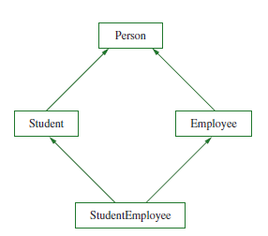
USING VIRTUAL BASE CLASSES
To avoid this duplicate inheritance, you use the keyword virtual when you define each of the child classes. The word virtual indicates that the base class should be used only once
The headers of the classes become:
class Student : virtual public Person
and
class Employee : public virtual Person
class StudentEmployee : public Student, public Employee
The StudentEmployee class ends up being a descendant of Person two times; without intervention, StudentEmployee would end up with two copies of each member of Person

Slide 32
USING VIRTUAL BASE CLASSES
Alternately, you could define StudentEmployee using the keyword virtual in its class definition, as follows
class StudentEmployee: virtual public Student, virtual public Employee
By adding virtual to the StudentEmployee inheritance definition, you forestall problems when new classes are created based on StudentEmployee and another of the classes in its family tree

Slide 33
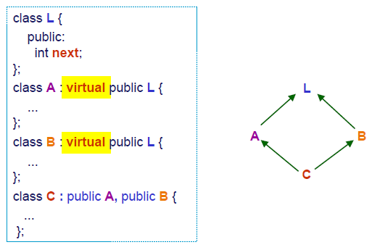
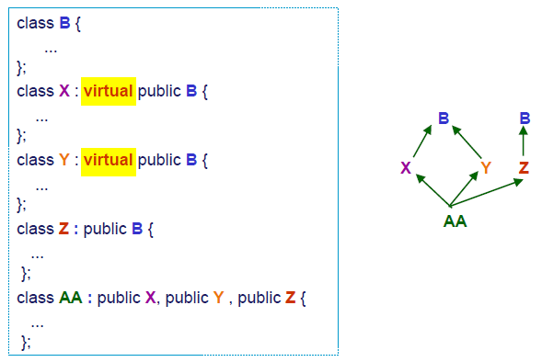
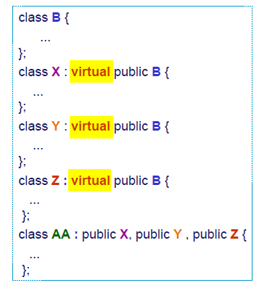

USING VIRTUAL BASE CLASSES

Slide 34
Advantages of Inheritance
Saves time because much of the code needed for your class is already written
Saves additional time because the existing code has already been tested—that is, you know it works correctly; it is reliable
Saves even more time because you already understand how the base class works, and you can concentrate on the complexity added as a result of your extensions to the class
In a derived class, we can extend and revise a parent class without corrupting the existing parent class features. In other words, you don’t have to modify a parent class to get it to work correctly with your new category of objects; you leave the original class alone
If other classes have been derived from the parent class, the parent class is even more reliable—the more its code has been used, the more likely it is that logical errors have already been found and fixed

Slide 35

Note
Besides being unable to directly access private members of a parent class, several parent class members are never inherited by the derived class
constructors
destructors
friend functions
overloaded new operators
overloaded = operators
If a derived class requires any of the preceding items, the item must be explicitly defined within the derived class definition

Slide 36
OVERRIDING AND OVERLOADING PARENT CLASS FUNCTIONS
When a new class is derived from an existing class, the derived class has access to nonprivate member functions in the base class
The new class also can have its own member functions
Those functions can have names that are identical to the function names in the base class
Any derived class function with the same name and argument list as the parent overrides the parent function
Any derived class function with the same name as the parent, yet with an argument list that differs from the base class, overloads the parent function

Slide 37
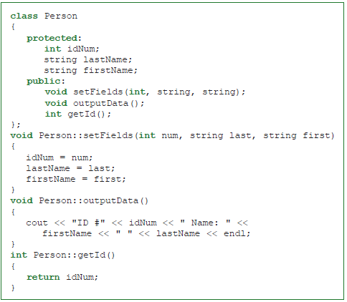
OVERRIDING AND OVERLOADING PARENT CLASS FUNCTIONS

Slide 38
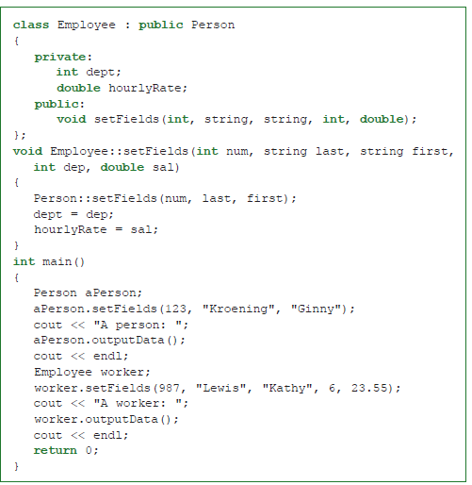
OVERRIDING AND OVERLOADING PARENT CLASS FUNCTIONS

Slide 39
Overriding Member Functions
When the same function exists in both the base class and the derived class, the function in the derived class is executed
#include <iostream>
using namespace std;
class Base {
public:
void print() {
cout << "Base Function" << endl;
}
};
class Derived : public Base {
public:
void print() {
cout << "Derived Function" << endl;
}
};
int main() {
Derived derived1;
derived1.print();
return 0;
}
Output
Derived Function

Slide 40
Overriding Member Functions
#include <iostream>
using namespace std;
class Base {
public:
void print() {
cout << "Base Function" << endl;
}
};
class Derived : public Base {
public:
void print() {
cout << "Derived Function" << endl;
}
};
int main() {
Derived derived1;
derived1.print();
derived1.Base::print();
return 0;
}
Output
Derived Function
Base Function

Slide 41
Overriding Member Functions
#include <iostream>
using namespace std;
class Base {
public:
void print() {
cout << "Base Function" << endl;
}
};
class Derived : public Base {
public:
void print() {
Base:: print();
cout << "Derived Function" << endl;
}
};
int main() {
Derived derived1;
derived1.print();
return 0;
}
Output
Base Function
Derived Function

Slide 42
Derived Class Constructors
A base class constructor is invoked(if any) , when a derived class object is created
If base class constructor contains default constructor, then the derived class constructor need not send arguments to base class constructors explicitly
If a derived class has constructor, but base class has no constructor, then the appropriate derived class constructor executed automatically whenever a derived class object is created
Note:
The derived class need not have a constructor as long as the base class has no-argument constructor
However, if the base class has constructors with arguments (one or more) then it is mandatory for the derived class to have constructor and pass the arguments to the base class constructor

Slide 43
Derived Class Constructors
class B
{
int x;
public :
B( ) { cout<<”B::B( ) Ctor…”<<endl;}
};
class D : public B
{
int y;
public :
D( ) { cout<<”D::D() Ctor …”<<endl;}
};
main( )
{
D d;
}
B::B( ) Ctor …
D::D( ) Ctor …
Note : When an object of the derived class is created, the constructor of the base class is executed first and later the constructor of the derived class

Slide 44
Why the base class’s constructor is called on creating an object of derived class?
What happens when a class is inherited from other?
The data members and member functions of base class comes automatically in derived class based on the access specifier but the definition of these members exists in base class only
So, when we create an object of derived class, all of the members of derived class must be initialized but the inherited members in derived class can only be initialized by the base class’s constructor as the definition of these members exists in base class only. This is why the constructor of base class is called first to initialize all the inherited members

Slide 45
Derived Class Constructors
class B
{
int a;
public :
B( ) { a = 0; cout<<”B::B( ) Ctor…”<<endl;}
B(int x) { a =x; cout<<”B::B(int) Ctor…”<<endl;}
};
class D : public B
{ int b;
public :
D( ) { b =0; cout<<”D::D( ) Ctor…”<<endl;}
D(int x) { b =x; cout<<”D::D(int) Ctor…”<<endl;}
D(int x, int y) : B(y)
{ b =x; cout<<”D::D(int, int) Ctor…”<<endl;}
};
main( )
{
D d;
D d1(10);
D d2(10, 20);
}
B::B( ) Ctor…
D::D( ) Ctor…
B::B( ) Ctor…
D::D(int) Ctor…
B::B(int) Ctor…
D::D(int, int) Ctor…

Slide 46
Derived Class Destructors
Derived class destructors are called before base class destructors
class B
{
int x;
public :
B( ) { cout<<”B Constructor Invoked…”<<endl; }
~B( ) { cout<<”B Destructor Invoked …”<<endl; }
};
class D : public B
{
int y;
public :
D( ) { cout<<”D Constructor Invoked …”<<endl; }
~ D( ) { cout<<”D Destructor Invoked…”<<endl; }
};
main( )
{ D d; }
B Constructor Invoked…
D Constructor Invoked…
D Destructor Invoked…
B Destructor Invoked …

Slide 47
Single Inheritance
int main (int, char * []){
B b(2, 3);
return 0;
}
Output:
A::constructor
B::constructor
B::destructor
A::destructor
Order of execution
constructors: base class first then derived class
destructors: reverse of constructors
class A {
public:
A(int num): aInt(num) {
cout << "A::constructor"<<endl;;}
~A() {
cout <<"A::destructor"<<endl;}
protected:
int aInt;
};
class B: public A {
public:
B(int numa, int numb)
: A(numa), bInt(numb) {
cout << "B::constructor"<<endl;}
~B() {
cout << "B::destructor"<<endl;}
protected:
int bInt;
};
A
B

Slide 48
Single Inheritance – Contd.
// A and B are as declared
// in the previous slide
class C: public B {
public:
C(int numa, int numb, string s )
: B(numa, numb), cStr(s) {
cout << "C::constructor"<<endl;}
~C() {
cout << "C::destructor"<<endl;}
protected:
string cStr;
};
int main () {
C c(4, 7, "hello");
return 0;
}
Output:
A::constructor
B::constructor
C::constructor
C::destructor
B::destructor
A::destructor
A
B
C

Slide 49
Multiple Inheritance
class X {
public:
X(): xChar('D') {cout << "X::default constructor"<<endl;;}
X(char c): xChar(c) {cout << "X::constructor"<<endl;;}
~X() {
cout << "X::destructor"<<endl;}
protected:
char xChar;
};
class Y {
public:
Y(char c): yChar(c) {
cout << "Y::constructor"<<endl;;}
~Y() {cout << "Y::destructor"<<endl;}
protected:
char yChar;
};
class Z : public X, public Y {
public:
Z(char xC,char yC, int num)
: X(xC), Y(yC), zInt(num) {
cout << "Z::constructor"<<endl;}
~Z() {
cout << "Z::destructor"<<endl;}
protected:
int zInt;
};
int main () {
Z zObj('z', 'b', 8);
return 0; }
Output:
X::constructor
Y::constructor
Z::constructor
Z::destructor
Y::destructor
X::destructor
X
Y
Z

Slide 50
Multiple Inheritance – Contd.
class MI: public C, public Z {
public:
MI(int numa, int numb, string s, char xC, char yC, int numZ )
: C(numa, numb, s), Z(xC, yC, numZ) {cout << "MI::constructor"<<endl;}
~MI() { cout << "MI::destructor"<<endl;}
protected:
string cStr;
};
int main ( ) {
MI mi(2,4,"eve", 'r', 's', 26);
return 0;
}
Output:
A::constructor
B::constructor
C::constructor
X::constructor
Y::constructor
Z::constructor
MI::constructor
MI::destructor
Z::destructor
Y::destructor
X::destructor
C::destructor
B::destructor
A::destructor
A
Y
X
B
Z
C
MI

Slide 51
All Base Class Constructors are Called
// X and Y as declared previously
class R : public X, public Y {
public:
R(char xC, char yC, int numx): Y(yC), X(xC), rInt(numx) {cout <<
"R::constructor" << endl;}
~R() {
cout << "R::destructor" <<endl;}
protected:
int rInt;
};
class S : public Y, public X {
public:
S(char yC, int numx): Y(yC), sInt(numx) {cout << "S::constructor"<<endl;}
~S() {cout << "S::destructor"<<endl;}
protected:
int sInt;
};
int main ( ) {
R r ('x', 'y', 8);
return 0;
}
Output:
X::constructor
Y::constructor
R::constructor
R::destructor
Y::destructor
X::destructor
int main () {
S s('y', 10);
return 0;
}
Output:
Y::constructor
X::default constructor
S::constructor
S::destructor
X::destructor
Y::destructor

Slide 52
Constructor Execution Order for Class Objects
Constructors of Virtual base classes are executed, in the order that they appear in the base list
class V { public: V() { cout << "V()" << endl; } };
class V2 { public: V2() { cout << "V2()" << endl; } };
class A { public: A() { cout << "A()" << endl; } };
class B : virtual V { public: B() { cout << "B()" << endl; } };
class C : B, virtual V2 { public: C() { cout << "C()" << endl; } };
class D : C, virtual V { public: A obj_A;
D() { cout << "D()" << endl; } };
int main() {
D c;
}
Output
V()
V2()
B()
C()
A()
D()

Slide 53
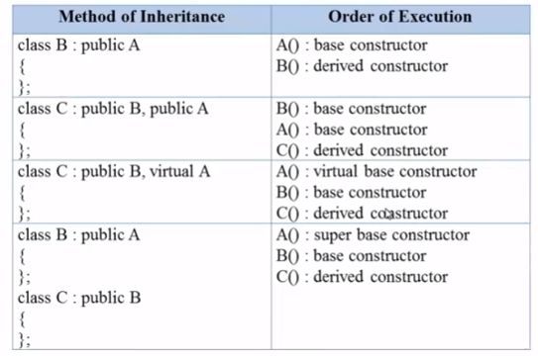
Order of Execution of Constructors

Slide 54
Whole/Part Relationships
The inheritance relationship between two classes could be described as an "is a" relationship
The whole/part relationship, often exemplified by the "has a" phrase
There are two different ways of implementing the whole/part relationship in C++
Aggregation
Composition

Slide 55
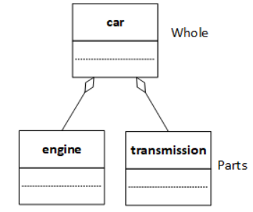
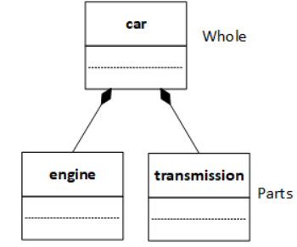
Whole/Part Relationships
Aggregation
Composition
Aggregation is implemented with a pointer member variable while composition is implemented with a non-pointer variable
In both cases, we can read the relationship as a car has an engine or a car has a transmission. The same relationship can be read in the opposite directions as "part of:" an engine is part of a car or a transmission is part of a car. Notice that it doesn't sound right to say that "an engine is a car" or that "a car is an engine"

Slide 56
Whole/Part Relationships
Composition
Parts are implemented as non-pointer member variables in the whole class
The part objects are bound strongly or tightly to the whole object - the parts are embedded inside the whole
The parts are created and destroyed at the same time that the whole is created and destroyed
Once created, the parts can't be changed
The parts are not shared with any other object in the program
Aggregation
Parts are implemented as pointer member variables in the whole class
The part objects are bound weakly or loosely to the whole object - the parts exist outside the whole
The parts and the whole may be created and destroyed at different times
The parts can be changed or replaced whenever it is convenient
The parts may be shared with other objects in the program, making ownership of the part an important issue

Slide 57
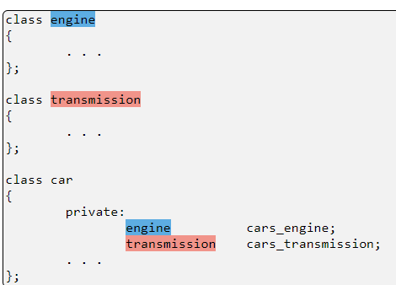
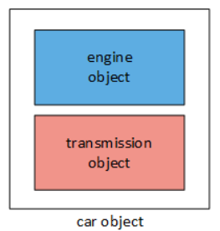
Composition: Embedded Objects
Building a whole/part relationship with member variables is just a small step beyond the simple classes
Building a whole/part object. A car (the whole) is created from an engine and a transmission (the parts). The whole/part relationship is implemented with two member variables (highlighted with blue and red) in the car class, one variable for each part object. When a program makes an instance of the car class, it simultaneously makes instances of the engine and transmission classes, which are embedded inside the car object.

Slide 58
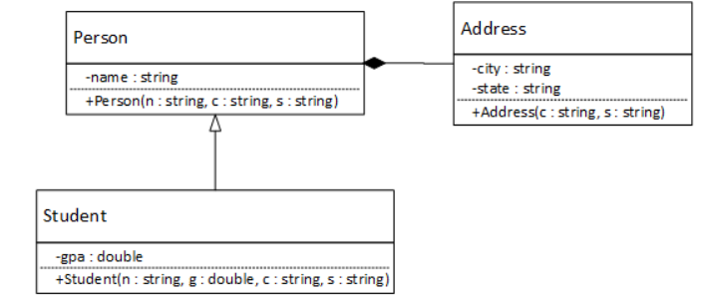
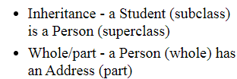
Initializing Embedded Part Objects

Slide 59
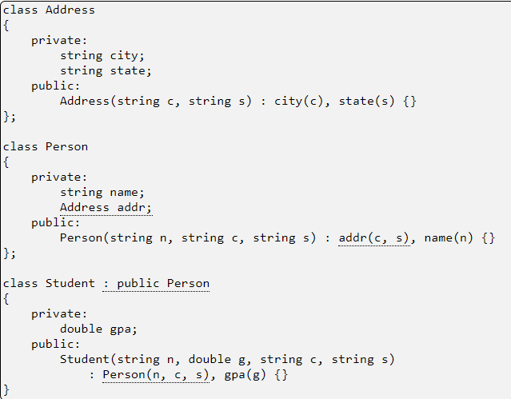
Initializing Embedded Part Objects

Slide 60
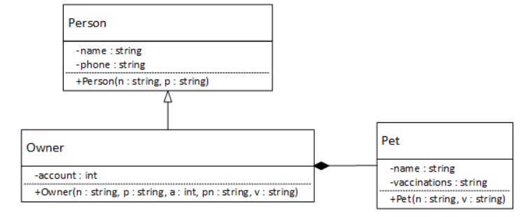
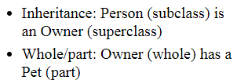
Initializing Embedded Part Objects – Example 2

Slide 61
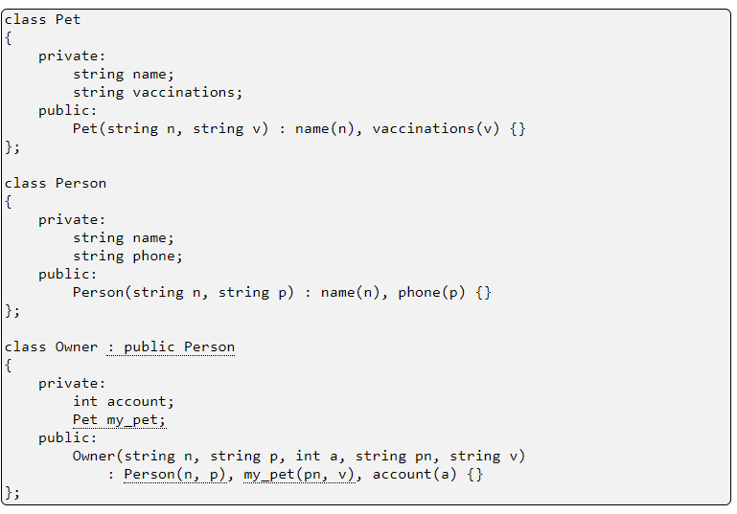
Initializing Embedded Part Objects

Slide 62
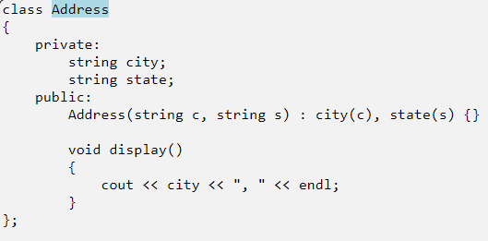
Using Embedded Part Objects

Slide 63
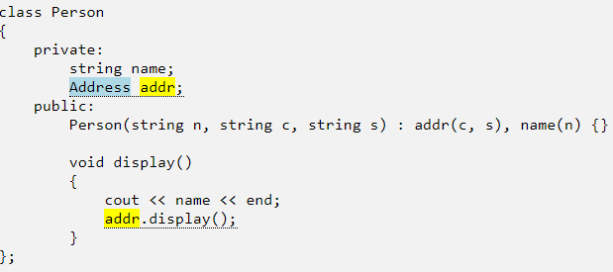
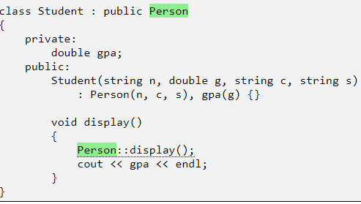

Using Embedded Part Objects

Slide 64
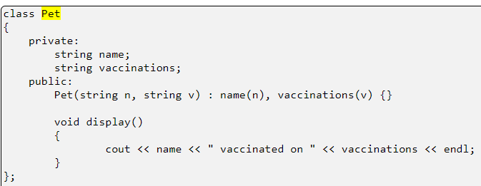
Using Embedded Part Objects – Example 2

Slide 65
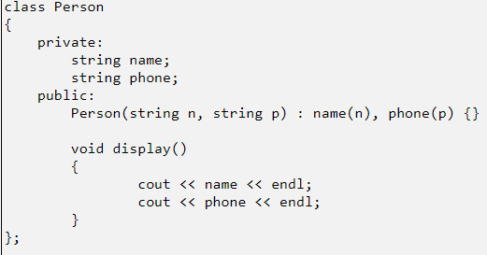
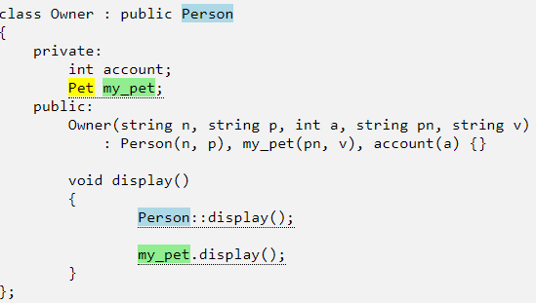

Using Embedded Part Objects – Example 2

Slide 66
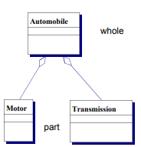

Aggregation: Pointer Member Variables
Whole-part, “has a,” or “a part of”
Form of association
Weak ownership / binding
Parts & whole have independent lifetimes
Instantiate parts when convenient
Build relationship when convenient
Parts may belong to multiple wholes
Parts may change during execution
Example

Slide 67
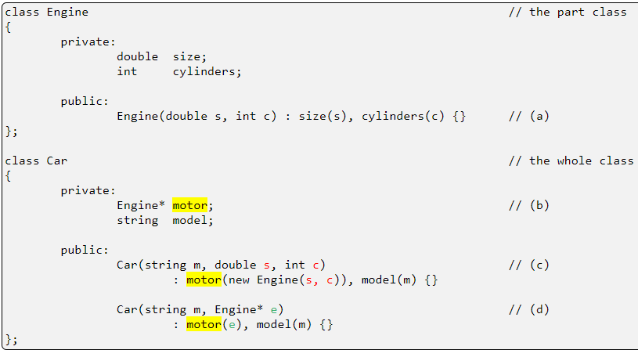
Aggregation - Example

Slide 68
Aggregation - Example
(a) The Engine or part class, which has two member variables and a constructor with two parameters
(b) The Car class's pointer member variable. Once the name of the member variable is established, it must be used consistently in the initializer lists below
(c) The "raw material" (i.e., the data) needed to build a new Engine is received as parameters (red) to the Car constructor. The initializer list creates a new Engine object and stores the address of the new object in the pointer member variable. Notice that new Engine(s, c)) calls the Engine constructor, so the number and type of arguments in the function call must match the number and type of parameters in class Engine
(d) The single parameter of the second constructor is a pointer to an existing Engine object (green), and the initializer list stores it in the pointer member variable

Slide 69
Aggregation - Example
Setter Initialization And Management
It may not always be practical to initialize a pointer member with a constructor at the same time that the whole object is created, and, at other times, there may be a need to change the object to which a pointer member points. In both of these cases, the solution is to use an accessor or setter function
Difference between constructors and setters
A constructor creates a new object, so the pointer member cannot be pointing at a part object when the constructor runs
A setter function may be initializing or setting a value in a pointer for the first time, or it may be changing the pointer by replacing an existing object. Unlike a constructor, a setter must detect which situation applies and behave appropriately

Slide 70
Aggregation - Example
Initializing and maintaining a pointer member with a setter function
void car::set_motor(double s, int c)
{
if (motor != nullptr)
delete motor;
motor = new Engine(s, c);
}
class Car
{
private:
Engine* motor;
string model;
public:
Car(string s) : model(s), motor(nullptr) { }
void set_motor(double s, int c);
void set_motor(Engine* e);
};
void car::set_motor(Engine* e)
{
motor = e;
}

Slide 71
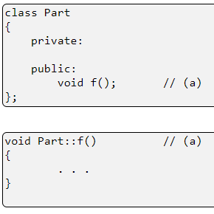
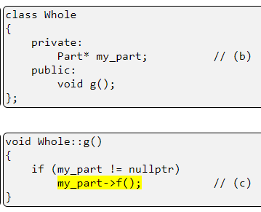
Aggregation - Example
Using Pointer Member Variables
(a) The Part class has a function f that can access the private features of the part class
(b) The Whole class has a pointer member variable, my_part, that can point to an instance of class Part
(c)The Whole class has a function g that can call function f through the pointer member. The if-statement is important: if my_part is null, then the function call (highlighted) will cause the program to fail

Slide 72
Aggregation or Composition?
Car
4
Wheel
Person
Brain
Aggregation is a relationship in which one object is a part of another
A aggregates B
=
B is part of A, but their lifetimes may be different
Composition is a relationship in which one object is an integral part of another
A contains B
=
B is part of A, and their lifetimes are the same

Slide 73
Association
Associations are connections between peer classes
Allows objects to send each other messages
Allows objects to call each other’s functions/methods
A link is an instance of an association and connects objects
Implemented as address variables (pointers in C++)
Associated objects
May have different life times
May change relationships dynamically or persist once created
May participate in multiple associations
Associations are usually bidirectional
The association may be named or labeled
Optional arrow head indicates the direction that the name is read
Can be unidirectional (line becomes an arrow)

Slide 74
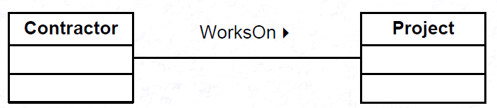
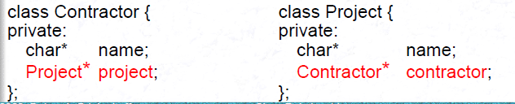
Implementing Association

Slide 75
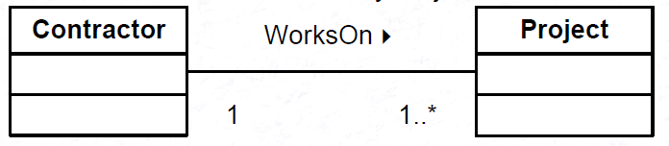
Multiplicity / Cardinality
Multiplicity
1 exactly 1
0..1 0 or 1
1..* 1 or more
0..* 0 or more
2,4 2 or 4 (other numbers are permitted)
2..4 2, 3, or 4 (other numbers are permitted)
1 Contractor works on 1 to many Projects

Slide 76
Association
An association is a structural relationship that specifies that objects of one thing are connected to objects of another
Associations can be adorned with a name
Associations can be adorned with the multiplicity
Faculty
Student
Teaching
Faculty
Student
Faculty
Student
1
4..*

Slide 77



Association
An association only denotes a semantic dependency and does not state the direction of this dependency (unless otherwise stated, an association implies bidirectional navigation)
A single student can associate with multiple teachers
Every Instructor has one or more Students
We can also indicate the behavior of an object in an association (i.e., the role of an object) using role names

Slide 78
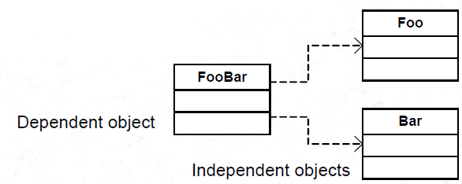
Dependency Relationship
One object needs a service/operation of another object
Maintains object integrity (encapsulation) & responsibility
Is implemented through local-scope objects
passing an object as a parameter to a function/method
instantiating a local object
Ephemeral form of association
Also known as delegation or using

Slide 79
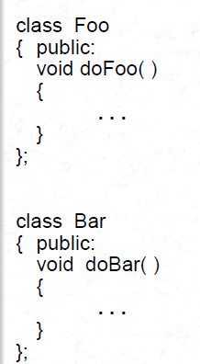
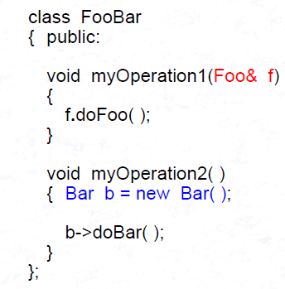
Dependency Relationship

Slide 80
UML Class Diagram
Describe the classes in the system and the static relationships between classes
Multiplicity
Customer
1
Class
Aggregation
Abstract
Class
Rental Invoice
Rental Item
{abstract}
1..*
1
0..1
Composition
Association
Generalization
Checkout Screen
DVD Movie
CD Music
Video Game

